Slide 1
CSE 241 OOP
Fall 2025
Quiz #8

Slide 2
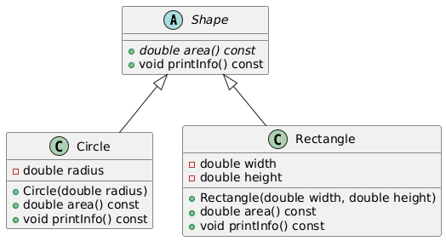
35 minutes…
Study the class hierarchy on the left. area is a pure virtual and printInfo is a virtual function. Do not implement these classes, assume they are already implemented.
Part 1: Design and implement a class template ShapeContainer<T> where T is expected to be a type derived from Shape. ShapeContainer should store a collection of pointers to objects of type T in a std::vector and provide methods to (1) add a shape, (2) return the total area of all stored shapes and (3) return the number of stored Circle .
Part 2: Implement main() that (1) creates a ShapeContainer<Shape> object (2) adds Circle and Rectangle objects to the container (3) calls the method to print the areas of all stored shapes, (4) calls the method to print the number of all circles.
Notation:
Red squares: private members
Green circles: public members

